Slide 1

Purchase Time
By
Kumaran S
Vignesh V

Slide 2
For Whom?
Simple E-commerce site for a local shop that will be able to deliver their products across city by themselves.
Don’t worry about the language, We have local Language support

Slide 3
What do You Get?
In Admin panel
Edit app name
Add/Edit Products
Invoice Report to analyse Sale Data
Admin username password change

Slide 4
What do You Get?
For Customer
Two-Factor Authentication( OTP, Password )
List of Top Deals & Top Selling Products
User Account (Login, Signup, Reset Password, Repeat Order, Online Payment)
Invoice Bill to Mail

Slide 5
Integrated Services
SMS Service
PDF Generation
Excel Generation
Email With Attachment
Payment Gateway
Language Support

Slide 6
Included Features
Multiple Languages
2FA (OTP based login)
Reset Password with Token
Simple and elegant Material/Bootstrap UI
Dynamic Custom Invoice generation
Stripe Payment
Customization of App by Client is Easy

Slide 7
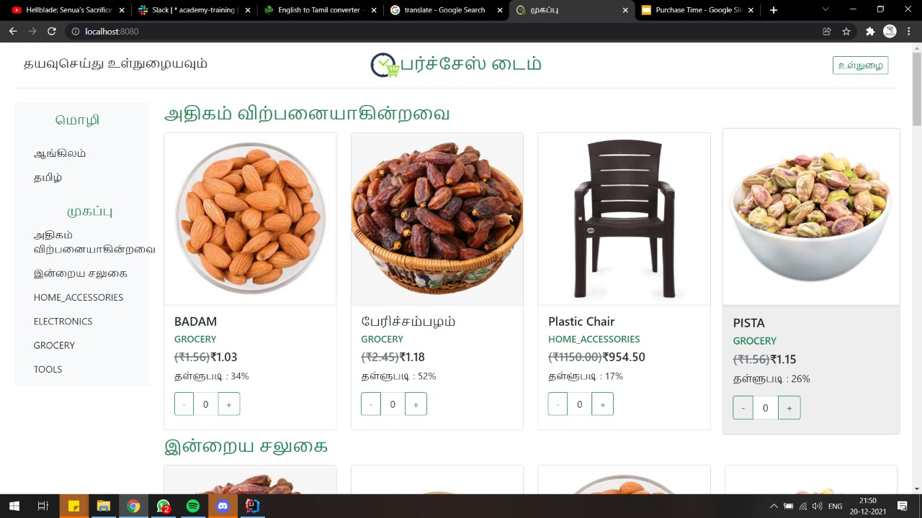
Snapshots

Slide 8
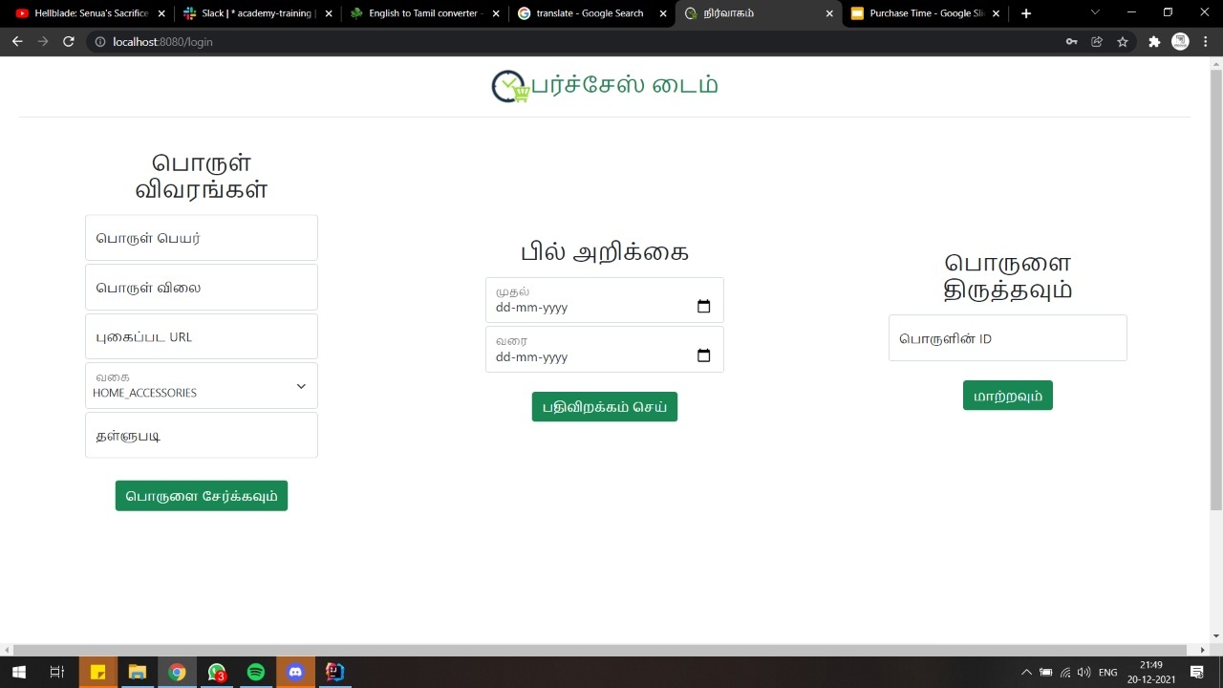
Snapshots

Slide 9
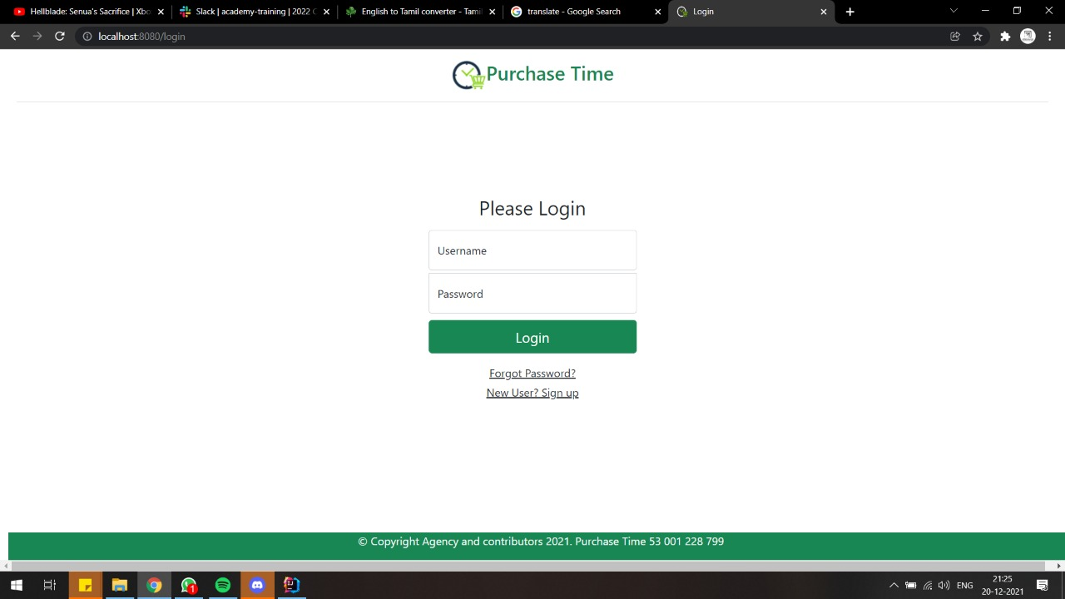
Snapshots

